Slide 1
Lecture 7
Tuesday, February 7, 2017
Transportation

Slide 2
I. Some basic facts

Slide 3
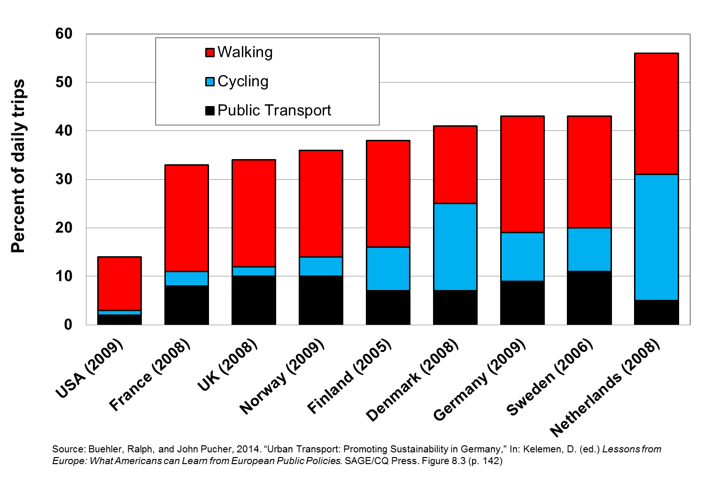
% of Urban Trips by type of transportation (2005-9)

Slide 4
Trends in Annual public transit ridership in the U.S., 1900-2010

Slide 5
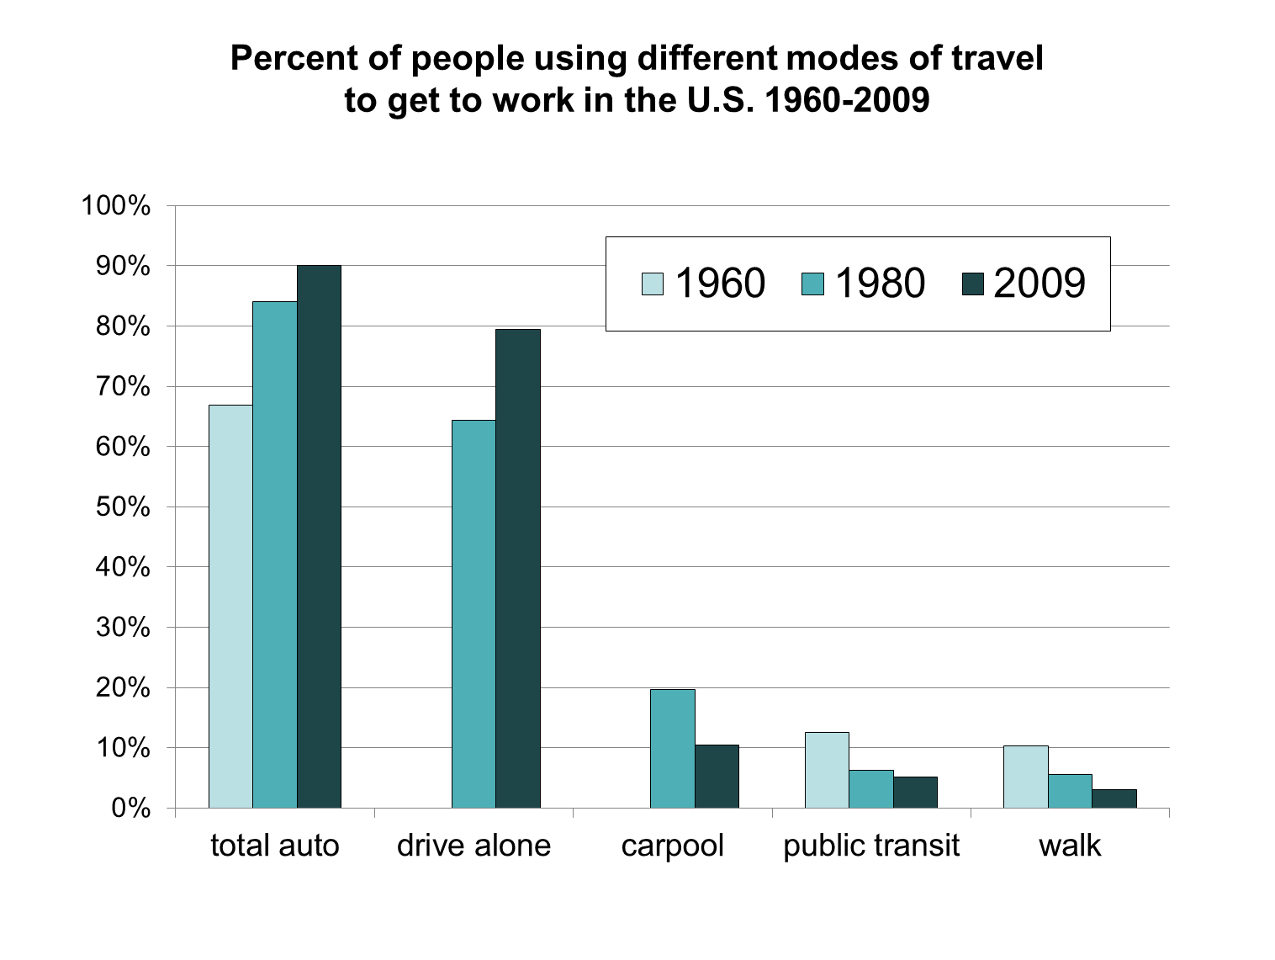

Slide 6
Annual Per Capita Gas Consumption, 2003

Slide 7
Annual hours of delay per traveler due to traffic congestion

Slide 8
Annual cost of traffic congestion ($billions), 2011

Slide 9
II. Understanding the Problem

Slide 10
The Public Transportation Free Riding Problem: Busses vs. Cars
 |  | YOUR CHOICE
 |  | BUS | PRIVATE CAR
EVERYONE ELSE’S CHOICE | BUS | A 25 minutes | B 10 minutes
 | PRIVATE CAR | C 1.5 hours | D 45 minutes
Free-riding preferences: B > A > D > C
Free riding gain: 15 Minutes (A minus B)
“Sucker penalty”: 45 minutes (C minus D)

Slide 11
The Public Transportation Free Riding Problem: Light Rail vs. Cars
 |  | YOUR CHOICE
 |  | RAIL | PRIVATE CAR
EVERYONE ELSE’S CHOICE | RAIL | A 15 minutes | B 10 minutes
 | PRIVATE CAR | C 25 minutes | D 45 minutes
Free riding gain: 5 Minutes (A minus B)
“Sucker penalty”: There is no sucker penalty!

Slide 12
III. Positive externalities of good public transportation

Slide 13
What are the positive externalities of good public transportation?
Quicker commuting times, less congestion
Saving on private car infrastructure (parking ramps, street repairs, etc.)
Less pollution: less frequent house painting
Health benefits (asthma especially)
More efficient labor market, especially for poor (easier to get to jobs), therefore less need for welfare
Less need for multiple cars in a family
Energy savings
Key Question: What is the true economic value of the positive externalities of good public transportation?

Slide 14
What are the positive externalities of good public transportation?
Quicker commuting times, less congestion
Saving on private car infrastructure (parking ramps, street repairs, etc.)
Less pollution: less frequent house painting
Health benefits (asthma especially)
More efficient labor market, especially for poor (easier to get to jobs), therefore less need for welfare
Less need for multiple cars in a family
Energy savings
Key Question: What is the true economic value of the positive externalities of good public transportation?

Slide 15
What are the positive externalities of good public transportation?
Quicker commuting times, less congestion
Saving on private car infrastructure (parking ramps, street repairs, etc.)
Less pollution: less frequent house painting
Health benefits (asthma especially)
More efficient labor market, especially for poor (easier to get to jobs), therefore less need for welfare
Less need for multiple cars in a family
Energy savings
Key Question: What is the true economic value of the positive externalities of good public transportation?

Slide 16
What are the positive externalities of good public transportation?
Quicker commuting times, less congestion
Saving on private car infrastructure (parking ramps, street repairs, etc.)
Less pollution: less frequent house painting
Health benefits (asthma especially)
More efficient labor market, especially for poor (easier to get to jobs), therefore less need for welfare
Less need for multiple cars in a family
Energy savings
Key Question: What is the true economic value of the positive externalities of good public transportation?

Slide 17
What are the positive externalities of good public transportation?
Quicker commuting times, less congestion
Saving on private car infrastructure (parking ramps, street repairs, etc.)
Less pollution: less frequent house painting
Health benefits (asthma especially)
More efficient labor market, especially for poor (easier to get to jobs), therefore less need for welfare
Less need for multiple cars in a family
Energy savings
Key Question: What is the true economic value of the positive externalities of good public transportation?

Slide 18
What are the positive externalities of good public transportation?
Quicker commuting times, less congestion
Saving on private car infrastructure (parking ramps, street repairs, etc.)
Less pollution: less frequent house painting
Health benefits (asthma especially)
More efficient labor market, especially for poor (easier to get to jobs), therefore less need for welfare
Less need for multiple cars in a family
Energy savings
Key Question: What is the true economic value of the positive externalities of good public transportation?

Slide 19
What are the positive externalities of good public transportation?
Quicker commuting times, less congestion
Saving on private car infrastructure (parking ramps, street repairs, etc.)
Less pollution: less frequent house painting
Health benefits (asthma especially)
More efficient labor market, especially for poor (easier to get to jobs), therefore less need for welfare
Less need for multiple cars in a family
Energy savings
Key Question: What is the true economic value of the positive externalities of good public transportation?

Slide 20
What are the positive externalities of good public transportation?
Quicker commuting times, less congestion
Saving on private car infrastructure (parking ramps, street repairs, etc.)
Less pollution: less frequent house painting
Health benefits (asthma especially)
More efficient labor market, especially for poor (easier to get to jobs), therefore less need for welfare
Less need for multiple cars in a family
Energy savings
Key Question: What is the true economic value of the positive externalities of good public transportation?

Slide 21
What are the positive externalities of good public transportation?
Quicker commuting times, less congestion
Saving on private car infrastructure (parking ramps, street repairs, etc.)
Less pollution: less frequent house painting
Health benefits (asthma especially)
More efficient labor market, especially for poor (easier to get to jobs), therefore less need for welfare
Less need for multiple cars in a family
Energy savings
Key Question: What is the true economic value of the positive externalities of good public transportation?

Slide 22
IV. Why is Public Transportation so weak in the U.S.?

Slide 23
The LA Transportation Story
as told in
Who Framed Roger Rabbit?
https://www.youtube.com/watch?v=OquSczOMkO4#t=77.968382

Slide 24
V. Solutions

Slide 25
Solutions
No free parking
Build infrastructure for transportation alternatives: bike paths, rapid transit, etc.
Increase residential density within cities
The full cost of driving should be reflected in gas taxes
Fully recognize the value of positive externalities in the price of public transit tickets. (Implication: perhaps tickets should be free).

Slide 26
Solutions
No free parking
Build infrastructure for transportation alternatives: bike paths, rapid transit, etc.
Increase residential density within cities
The full cost of driving should be reflected in gas taxes
Fully recognize the value of positive externalities in the price of public transit tickets. (Implication: perhaps tickets should be free).

Slide 27
Solutions
No free parking
Build infrastructure for transportation alternatives: bike paths, rapid transit, etc.
Increase residential density within cities
The full cost of driving should be reflected in gas taxes
Fully recognize the value of positive externalities in the price of public transit tickets. (Implication: perhaps tickets should be free).

Slide 28
Solutions
No free parking
Build infrastructure for transportation alternatives: bike paths, rapid transit, etc.
Increase residential density within cities
The full cost of driving should be reflected in gas taxes
Fully recognize the value of positive externalities in the price of public transit tickets. (Implication: perhaps tickets should be free).

Slide 29
Solutions
No free parking
Build infrastructure for transportation alternatives: bike paths, rapid transit, etc.
Increase residential density within cities
The full cost of driving should be reflected in gas taxes
Fully recognize the value of positive externalities in the price of public transit tickets. (Implication: perhaps tickets should be free).

Slide 30
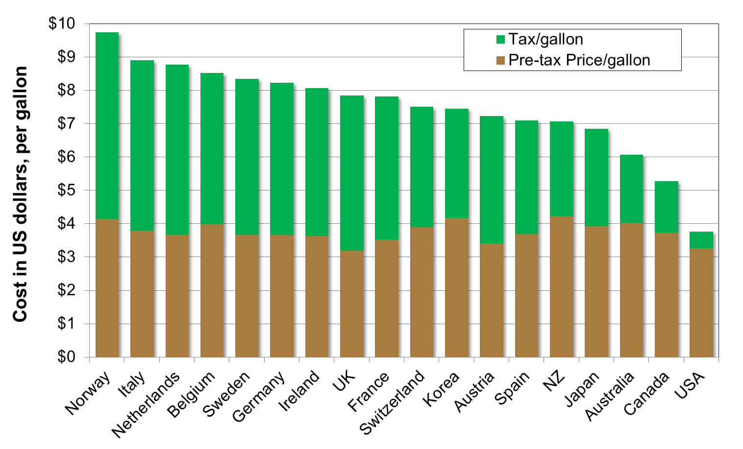
Gasoline prices and taxes in selected countries, 2012

Slide 31
Solutions
No free parking
Build infrastructure for transportation alternatives: bike paths, rapid transit, etc.
Increase residential density within cities
The full cost of driving should be reflected in gas taxes
Fully recognize the value of positive externalities in the price of public transit tickets. (Implication: perhaps tickets should be free).

Slide 32
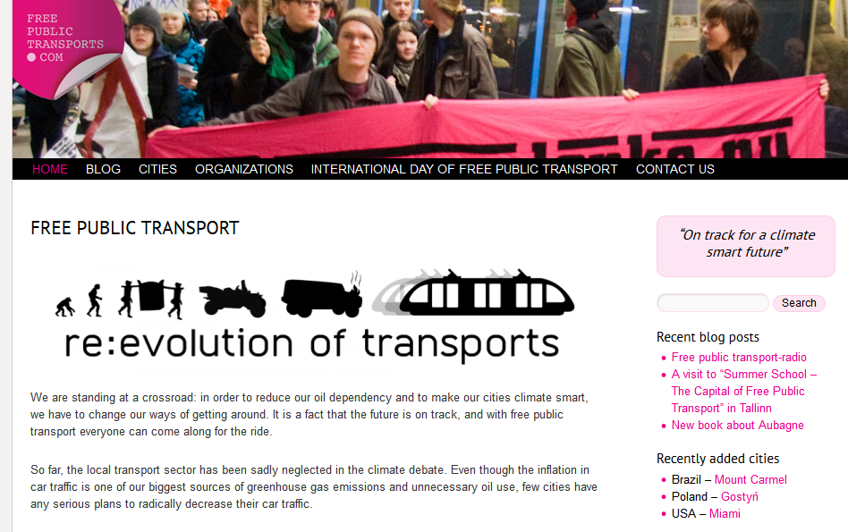
http://freepublictransports.com/

Slide 33
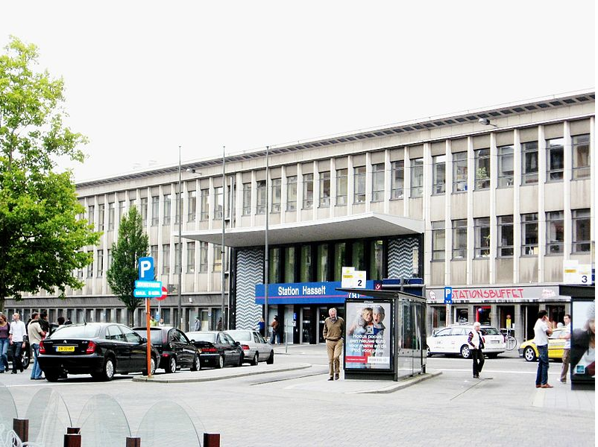
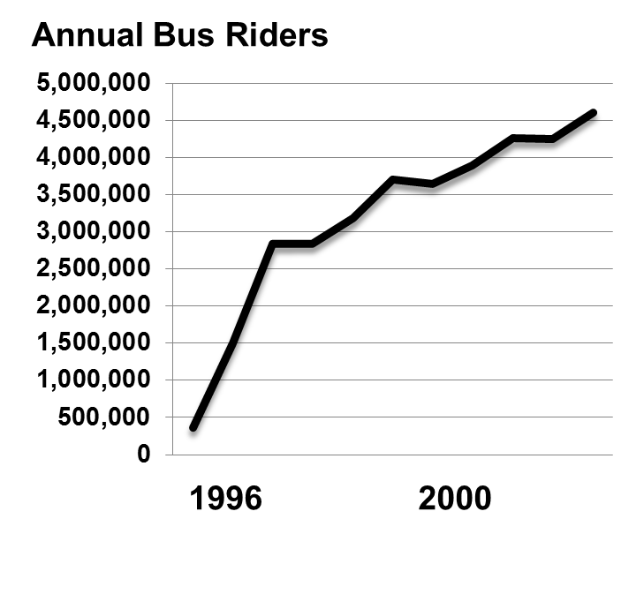
No-Fare Public Transportation in Hasselt, Netherlands
introduced July, 1997

Slide 34
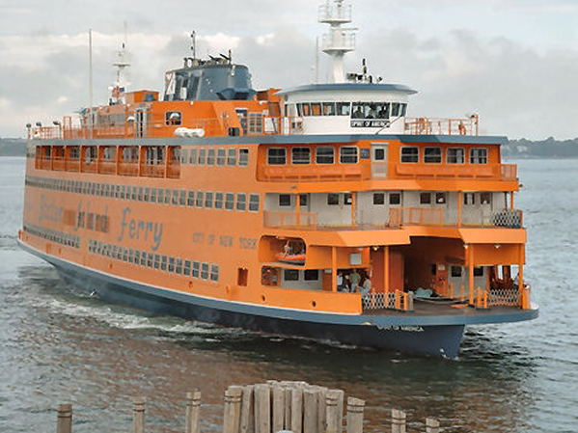
Staten Island Ferry: free public transport

Slide 35
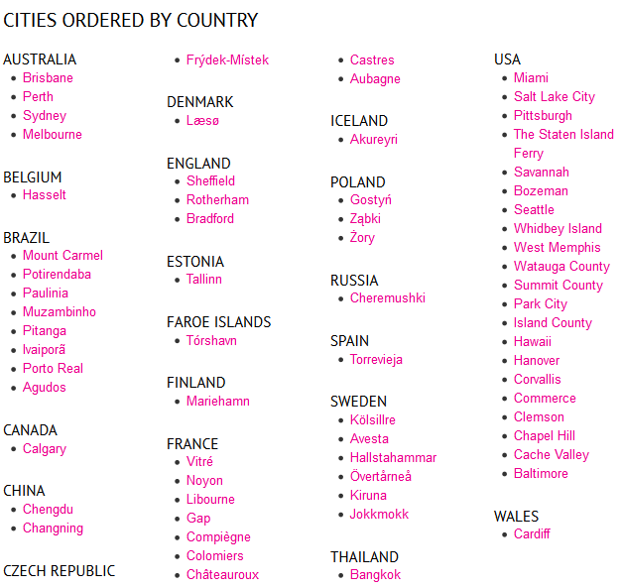
Cities with at least some free public transportation
http://freepublictransports.com/city/

Slide 36
Big Message
A free market in transportation is inefficient because:
There are large positive and negative externalities of different modes of transportation.
The optimal choice for an individual depends on the range of options available: You rent a car if you visit LA for a week, but not NYC. A free market cannot produce the optimal range of options from which to choose.

